Slide 1

TF-IDF SEARCH ENGINE
Assignment #2 - Presentation
Presented By: 2021-CS-118

Slide 2
Agenda
Objective
Steps to find TF-IDF of documents
Load Documents
Clean data and Tokenize
Find TF
Find IDF
Find TF-IDF
Query Handling and Ranking
Preprocessing and Query TF-IDF Vector
Calculate Cosine Similarity
User Interface
DFD
Conclusion

Slide 3
Objective
The objective of this assignment is to design and implement a document ranking system using the TF-IDF method. Main objective to this assignment to me is:
How to find meaning of sentences and documents

Slide 4
Steps to find TF-IDF of documents
Steps to find the TF-IDF of document are below:
Clean data / Preprocessing: Normalize data (all lower case)
Tokenize words with frequency
Find TF for words
Find IDF for words
Vectorize vocab by finding TF-IDF
Let’s cover an example of 3 documents:
Document 1 It is going to rain today.
Document 2 Today I am not going outside.
Document 3 I am going to watch the season premiere.
To find TF-IDF we need to perform the steps we laid out above, let’s get to it.

Slide 5
Clean data and Tokenize
Word | Count
going | 3
to | 2
today | 2
i | 2
am | 2
it | 1
is | 1
rain | 1

Slide 6
Find TF
TF = (Number of repetitions of word in a document) / (Total number of words in a document)
Words | Document 1 | Document 2 | Document 3
going | 0.16 | 0.16 | 0.12
to | 0.16 | 0 | 0.12
today | 0.16 | 0.16 | 0
i | 0 | 0.16 | 0
am | 0 | 0.16 | 0.12
it | 0.16 | 0 | 0
is | 0.16 | 0 | 0
rain | 0.16 | 0 | 0

Slide 7
Find IDF
IDF =Log[(Number of documents) / (Number of documents containing the word + 1)]
Word | IDF Value | IDF Value
going | log(3/3) | 0
to | log(3/2) | 0.41
today | log(3/2) | 0.41
i | log(3/2) | 0.41
am | log(3/2) | 0.41
it | log(3/1) | 1.09
is | log(3/1) | 1.09
rain | log(3/1) | 1.09

Slide 8
Find TF-IDF
TF-IDF = TF * IDF
We can use TF-IDF to compare results and use table to ask questions.
Words | going | to | today | i | am | it | is | rain
Document 1 | 0 | 0.07 | 0.07 | 0 | 0 | 0.17 | 0.17 | 0.17
Document 2 | 0 | 0 | 0.07 | 0.07 | 0.07 | 0 | 0 | 0
Document 3 | 0 | 0.05 | 0 | 0.05 | 0.05 | 0 | 0 | 0
We can easily see using this table that words like “it”, “is”, “rain” are important for document 1 but not for document 2 and document 3 which means Document 1 and 2&3 are different w.r.t talking about rain.
We can also say that Document 1 and 2 talk about something ‘today’, and document 2 and 3 discuss something about the writer because of the word ‘I’.
This table helps us to find similarities and non-similarities btw documents, words and more much better than any other approach.

Slide 9
Query Handling and Ranking
Let’s consider a query “It will Rain”. And let’s see how can we compute a Query Handling and Ranking.
Preprocessing and Query TF-IDF Vector
Word | Count | Query TF | IDF value | Query TF-IDF
it | 1 | 0.33 | 1.09 | 0.36
is | 1 | 0.33 | 1.09 | 0.36
rain | 1 | 0.33 | 1.09 | 0.36

Slide 10
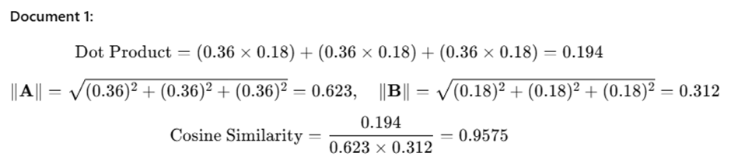
Query Handling and Ranking
Calculate Cosine Similarity
As we know the query tf-idf vector is = [0.36, 0.36, 0.36]
Also, we already have the document tf-idf vectors:
Document 1 = [0.18, 0.18, 0.18]
Document 2 = [0, 0, 0]
Document 3 = [0, 0, 0]

Slide 11
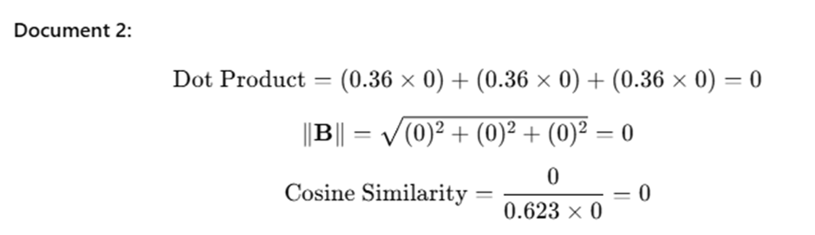
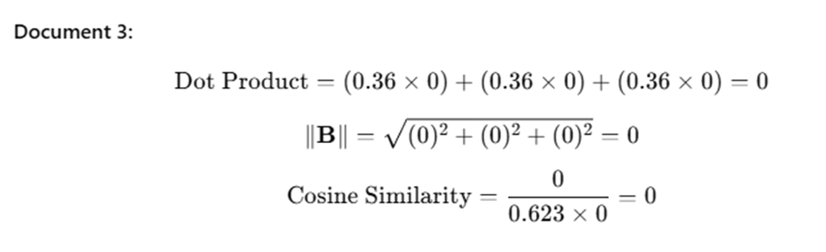
Query Handling and Ranking

Slide 12
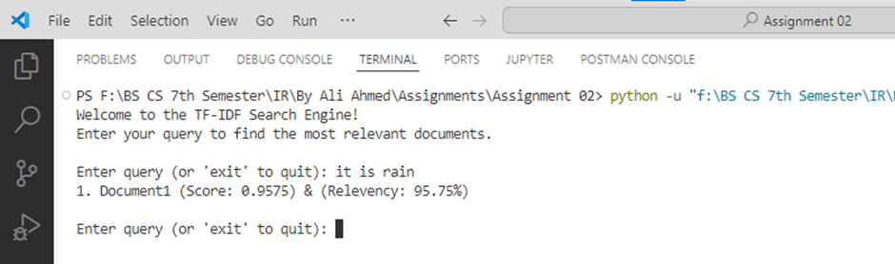
Display Result
Document 1 | 0.9575
Document 2 | 0
Document 3 | 0

Slide 13
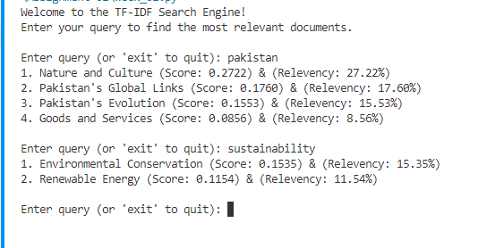
Steps to create System: User Interface

Slide 14
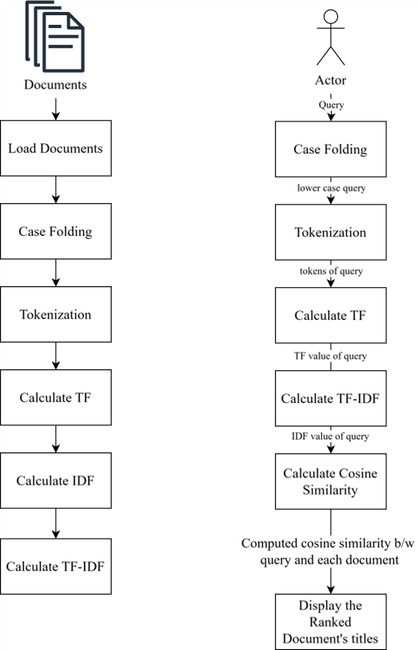
DFD

Slide 15
Thank You!

